Slide 1








Document Classification
Using Image & Text Features:
A Multi-Modal AI Approach
Under the Guidance of:
Dr. Chaojie Wang
DATA 606 – Capstone in Data Science
Submitted by:
Ujjwal (PF10610)
University of Maryland, Baltimore County

Slide 2

About Me
Ujjwal
Student, MPS Data Science
UMBC Global Ambassador
Graduate Grader, Data Science Department
University of Maryland, Baltimore County
Skills:
Python, SQL, MATLAB
Tableau, Microsoft Azure, Microsoft Office
Statistical Analysis, Data Visualization, Time-Series Analysis, Machine Learning, Deep Learning, Natural Language Processing
Projects:
California Drought Analysis & Prediction
Twitter Sentiment Analysis & Stock Prices Prediction
Rotor-Bar Fault Detection in 3 Phase Induction Motor

Slide 3
What is Document Classification?
1
Document
Item of information that has content related to some specific category.
Document Classification
2
Process of assigning categories
To documents to make them easier to manage, search, filter, or analyze.
3
Collaborative task
Dealing with text classification and visual classification

Slide 4
Why is Document Classification Important?
Crucial for Organizations
Effective
Fast and efficient
Helps in saving information
And
Finding documents whenever required
For collection and storage of data
And frees up human resources for better brainstorming works in any organization

Slide 5
About the Dataset
1
DATASET SOURCE:
Kaggle (link: https://www.kaggle.com/patrickaudriaz/tobacco3482jpg)
2
DATA SIZE:
2 GB
3
NUMBER OF ENTITIES:
3492 Documents
4
TYPES OF DOCUMENTS:
Advertisement, Email, Form, Letter, Memo, News, Note, Report, Resume, Scientific
5
RESEARCH PAPER:
Jayant Kumar, Peng Ye and David Doermann. "Learning Document Structure for Retrieval and Classification." International Conference on Pattern Recognition (ICPR 2012), 2012

Slide 6
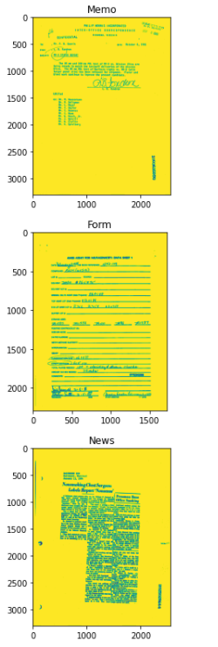
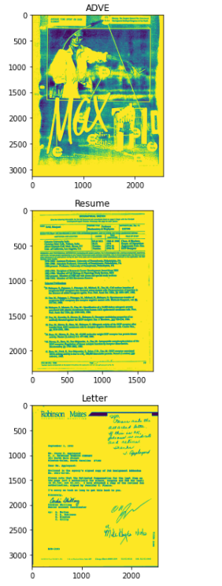
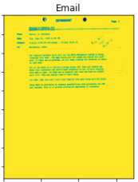
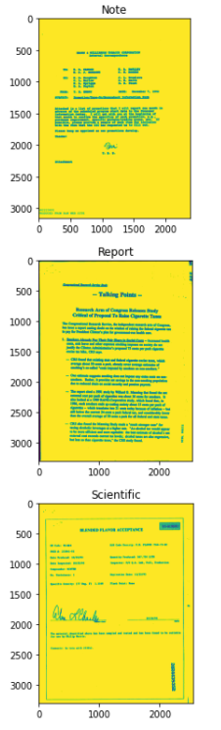
Sample Images From Dataset

Slide 7
Research Questions
Comparison
Manual Document Classification Vs Automated Document Classification
Impact
How automated document classification can impact an organization
Effectiveness
Of Multi-Modal approach

Slide 8





Methodology
05
04
03
02
01
Dataset Preparation
Text Preprocessing & Feature Engineering
Model Evaluations
Multi-Modal prediction
Model Tuning
Retrieving text from images using Optical Character Recognition (OCR) libraries
Using image features and textual features individually for model training and comparing the results
Combining image features and textual features for prediction
Observing effects of varying parameters
Text cleaning, tokenization, stemming, lemmatization, word clouds

Slide 9
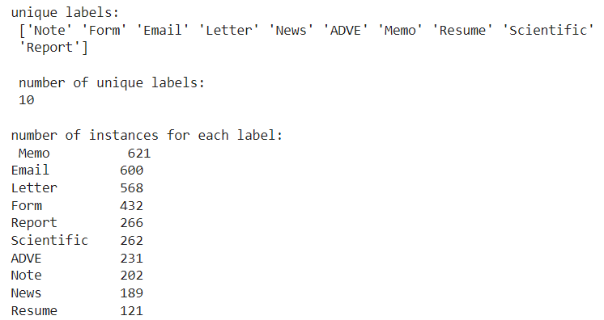
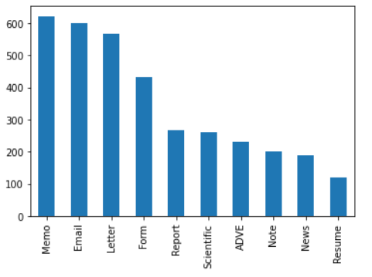
Initial Exploratory Data Analysis

Slide 10
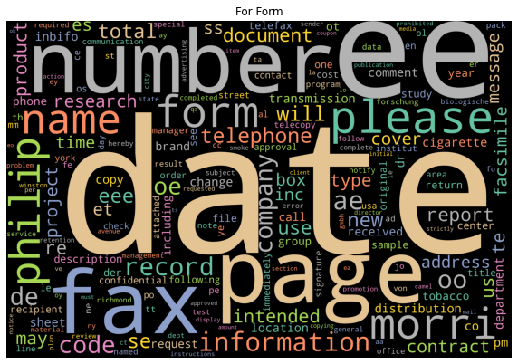
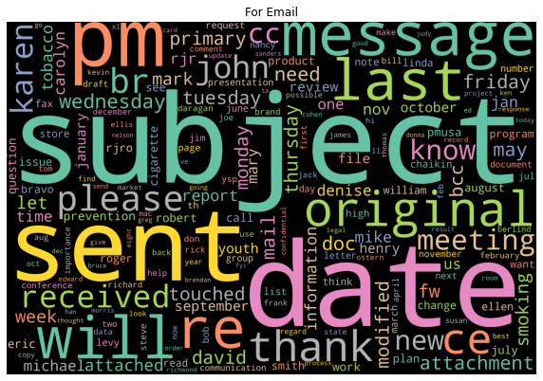
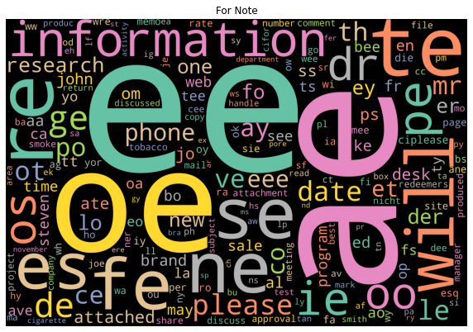
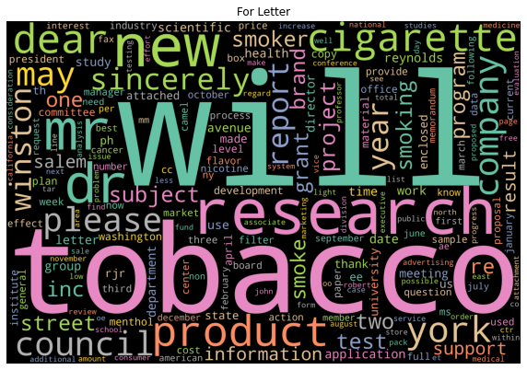
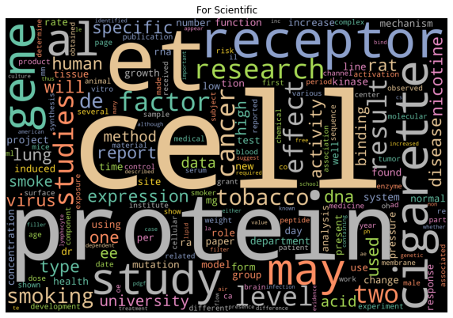
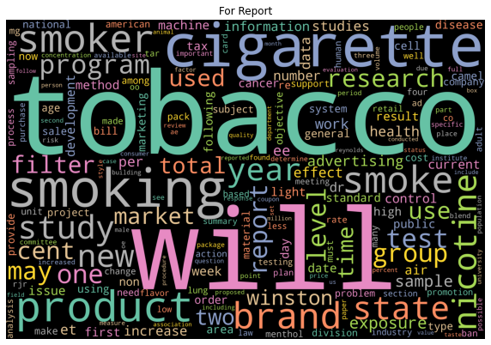
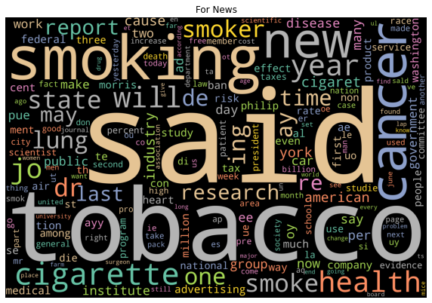
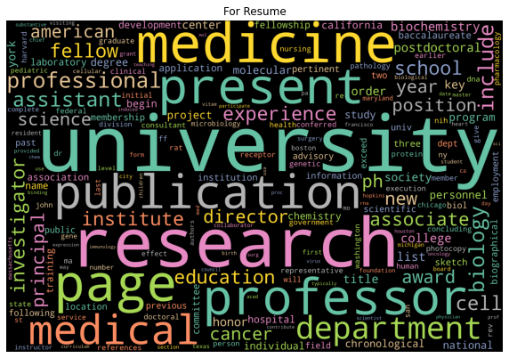
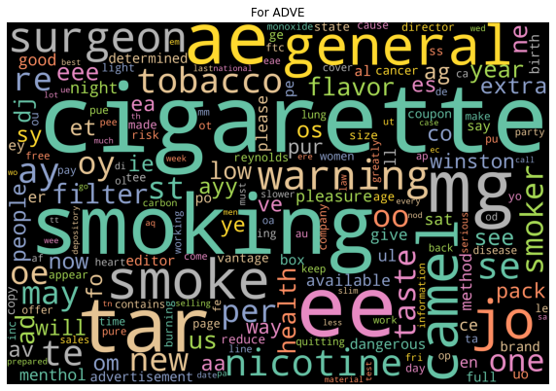
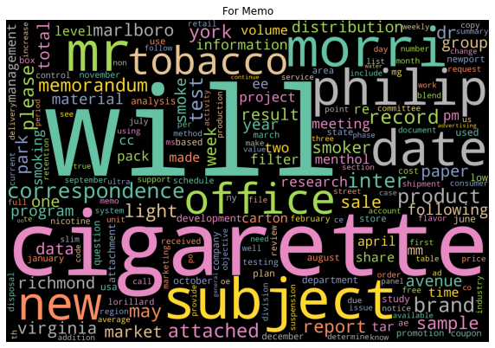
Word Clouds

Slide 11
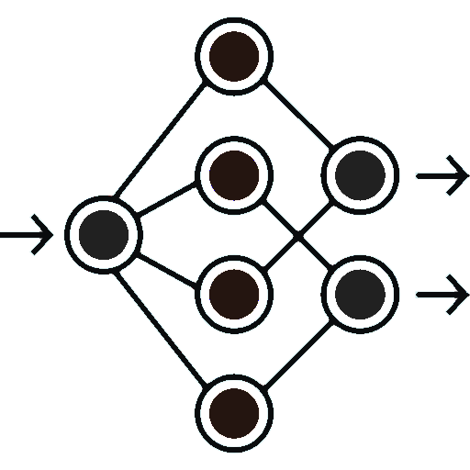

Machine Learning Models & Evaluation Metrics
Machine Learning Models
Evaluation Metrics
Convolutional Neural Networks
AlexNet
ResNet
XGBoost
RandomForest
Confusion Matrix
Accuracy
Precision
Recall (or Sensitivity)
F1-score
Specificity

Slide 12
What is Intended to be Established?
Development of a state-of-the-art multimodal document classifier which can leverage both types of data i.e., visual and text for making the final prediction.

Slide 13

References
https://www.altexsoft.com/blog/document-classification/
https://nanonets.com/blog/document-classification/
https://medium.com/@MohammedS/performance-metrics-for-classification-problems-in-machine-learning-part-i-b085d432082b
Jayant Kumar, Peng Ye and David Doermann. "Learning Document Structure for Retrieval and Classification." International Conference on Pattern Recognition (ICPR 2012), 2012.
Herbert L. Roitblat, Anne Kershaw, and Patrick Oot. 2010. Document categorization in legal electronic discovery: computer classification vs. manual review. J. Am. Soc. Inf. Sci. Technol. 61, 1 (January 2010), 70–80.
David Martens and Foster Provost. 2014. Explaining data-driven document classifications. MIS Q. 38, 1 (March 2014), 73–100. DOI:https://doi.org/10.25300/MISQ/2014/38.1.04
Presentation Templated Credit:
Slidesgo : https://slidesgo.com/
Freepik : https://www.freepik.com/

Slide 14

Thank You
Ujjwal – pf10610@umbc.edu

